Slide 1

Happy language
Southeast Missouri State University
CS390: Programming Language instructed by Dr. Lowe Bob
Project Group 4

Slide 2
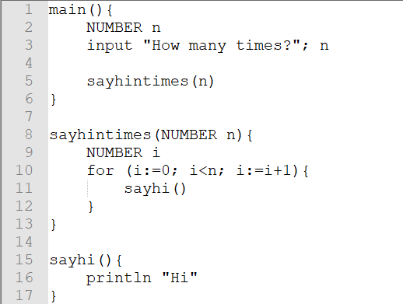
Program starts at “main”
In Happy, we start with the “main” function
Helper functions needs to defined following the “main”.

Slide 3
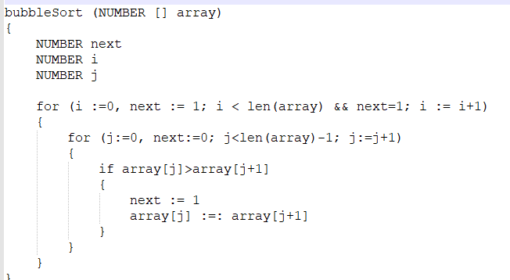
A block is wrapped around with { }

Slide 4
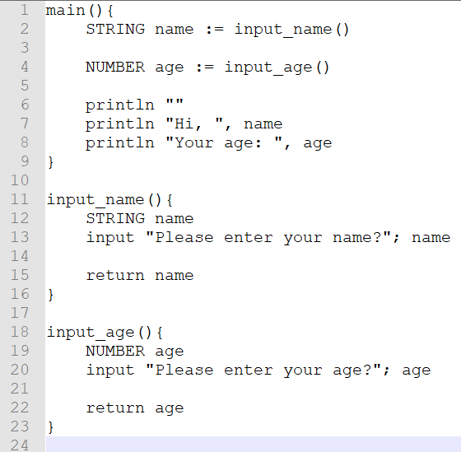
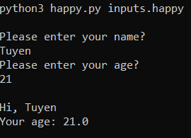
Primitive Data Types: Everything is either NUMBER or STRING
This is how you declare a primitive variable and do the assignment
In Happy, number is a float. All arithmetic operations are performed with floating point numbers

Slide 5
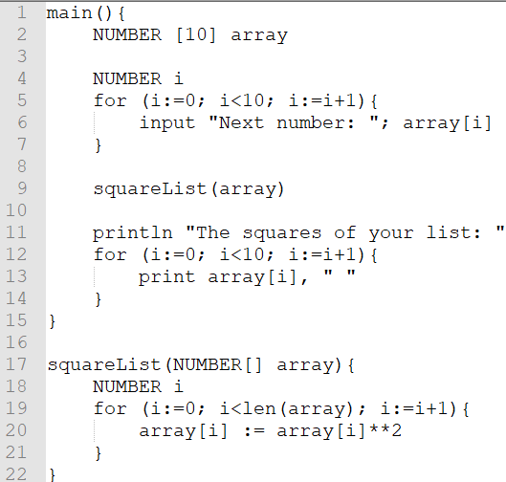
Collections: Happy supports working with Array and Stack
This is how you declare an array in Happy.
Array is a fixed length collection. Initially, all are 0.
This is how you declare a function’s array parameter
Array is passed by reference
Happy allows you to get the length of the array

Slide 6
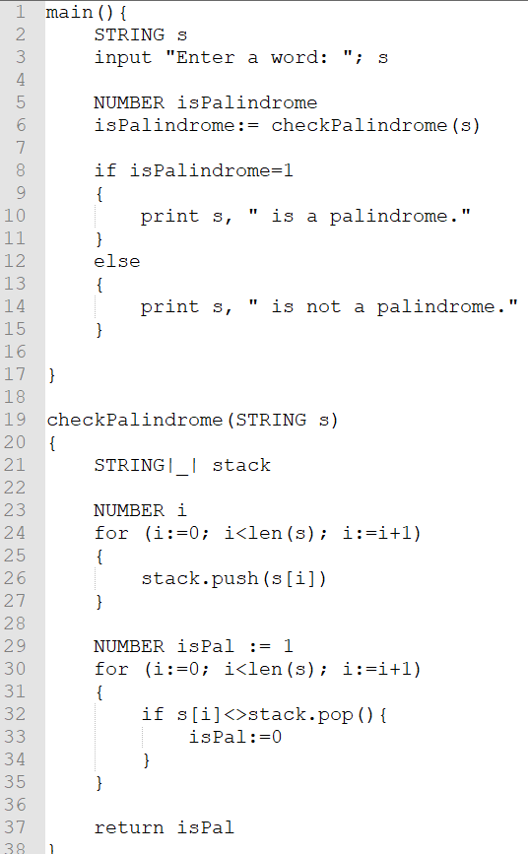
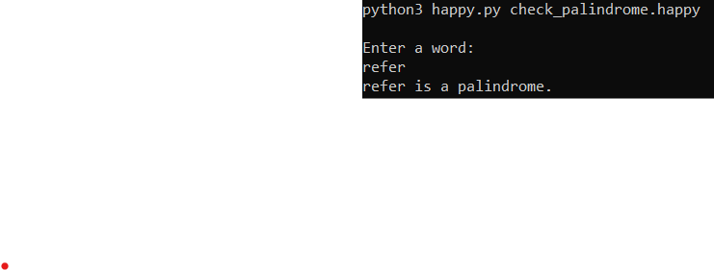
Collections: Happy supports working with Array and Stack
This is how you declare a stack in Happy.
push to the back of the collection
pop value from the back of the collection

Slide 7
String, Array, and Stack
For all of these, in Happy, we can:
Indexing with [i]
Retrieve the length with len

Slide 8
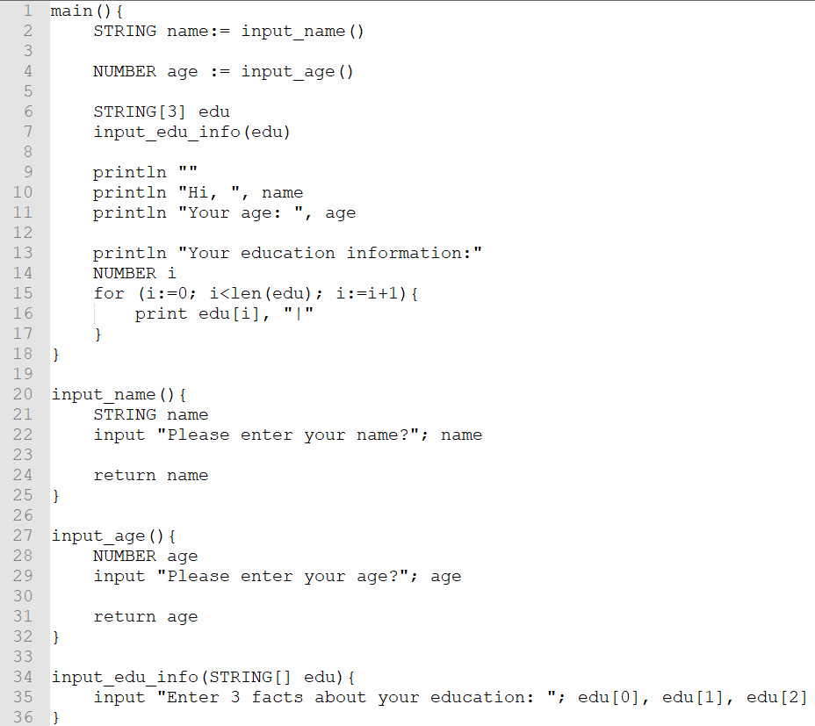
input
Input with PROMPT
Input casted to a FLOAT before assigning to a NUMBER variable
Multiple inputs

Slide 9
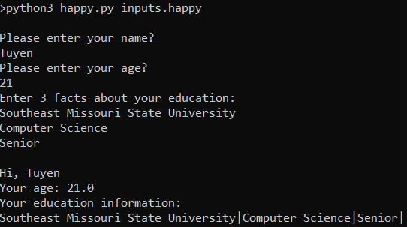
print and println
println to print one or many strings and enter the next line
print to print one or many strings and stay at the same line
Multiple arguments (separated by COMMA) to print and println are concatenated

Slide 10
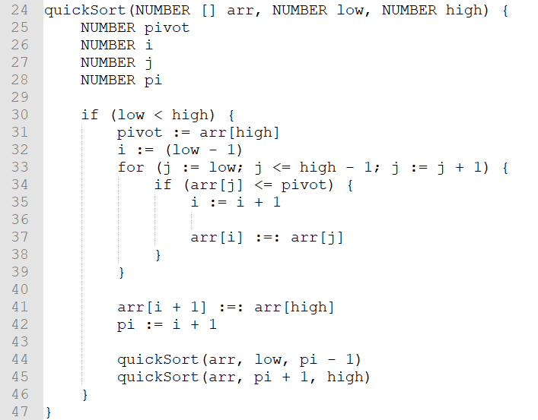
Assignment and Swap
Assignment with :=
Assignment with :=:

Slide 11
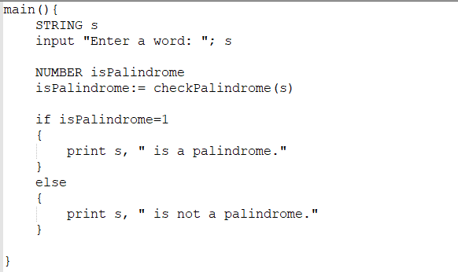
if and if-else

Slide 12
Happy symbols
Operator | Type
() [] . | Parentheses Array subscript Member method selection
** | Power
* / % | Multiplication Division Mod
+ - | Addition, Concatenation Subtraction
< <= > >= = <> | Less than Less than or equal Greater than Greater than or equal Equal to Not equal to
&& || | Logical AND Logical OR
:= :=: | Assignment Swap

Slide 13
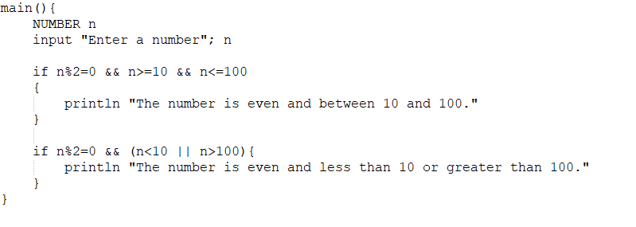
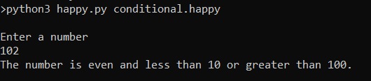
Conditional operations

Slide 14
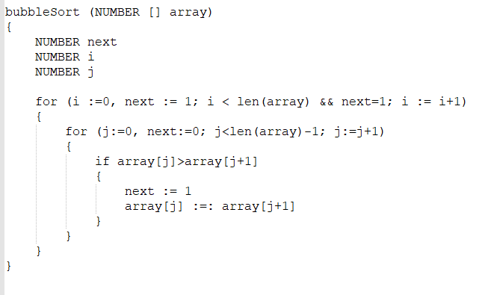
For loop

Slide 15
The sample programs

Slide 16

Hello World

Slide 17
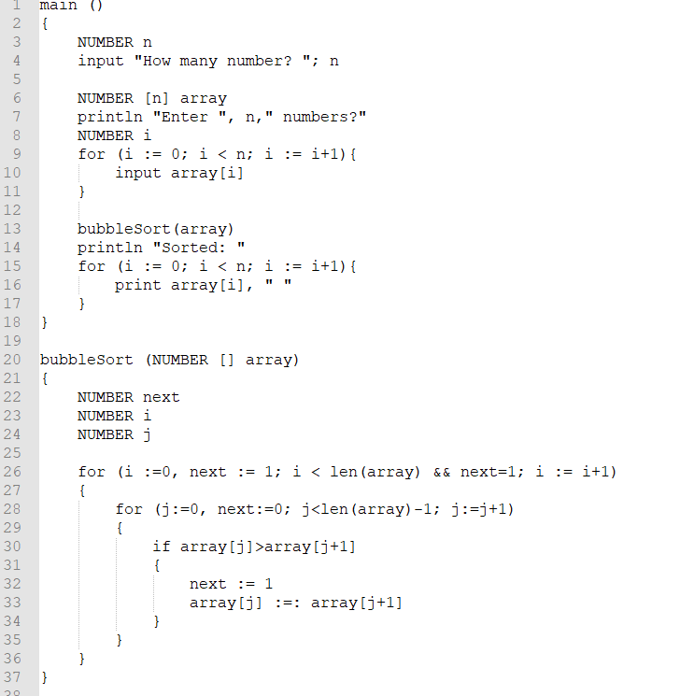
Bubble Sort

Slide 18
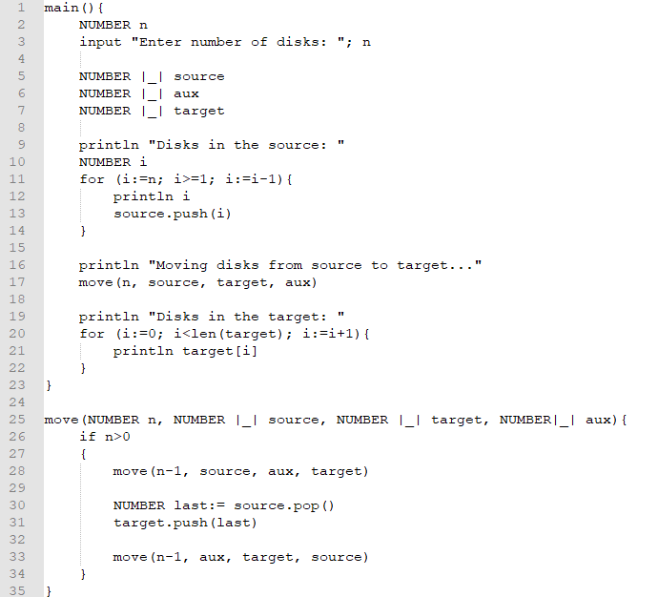
The Tower of Hanoi

Slide 19
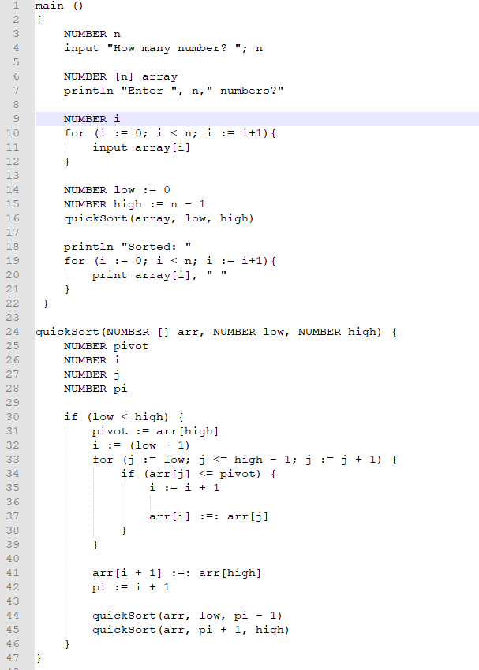
Quick sort

